Slide 1
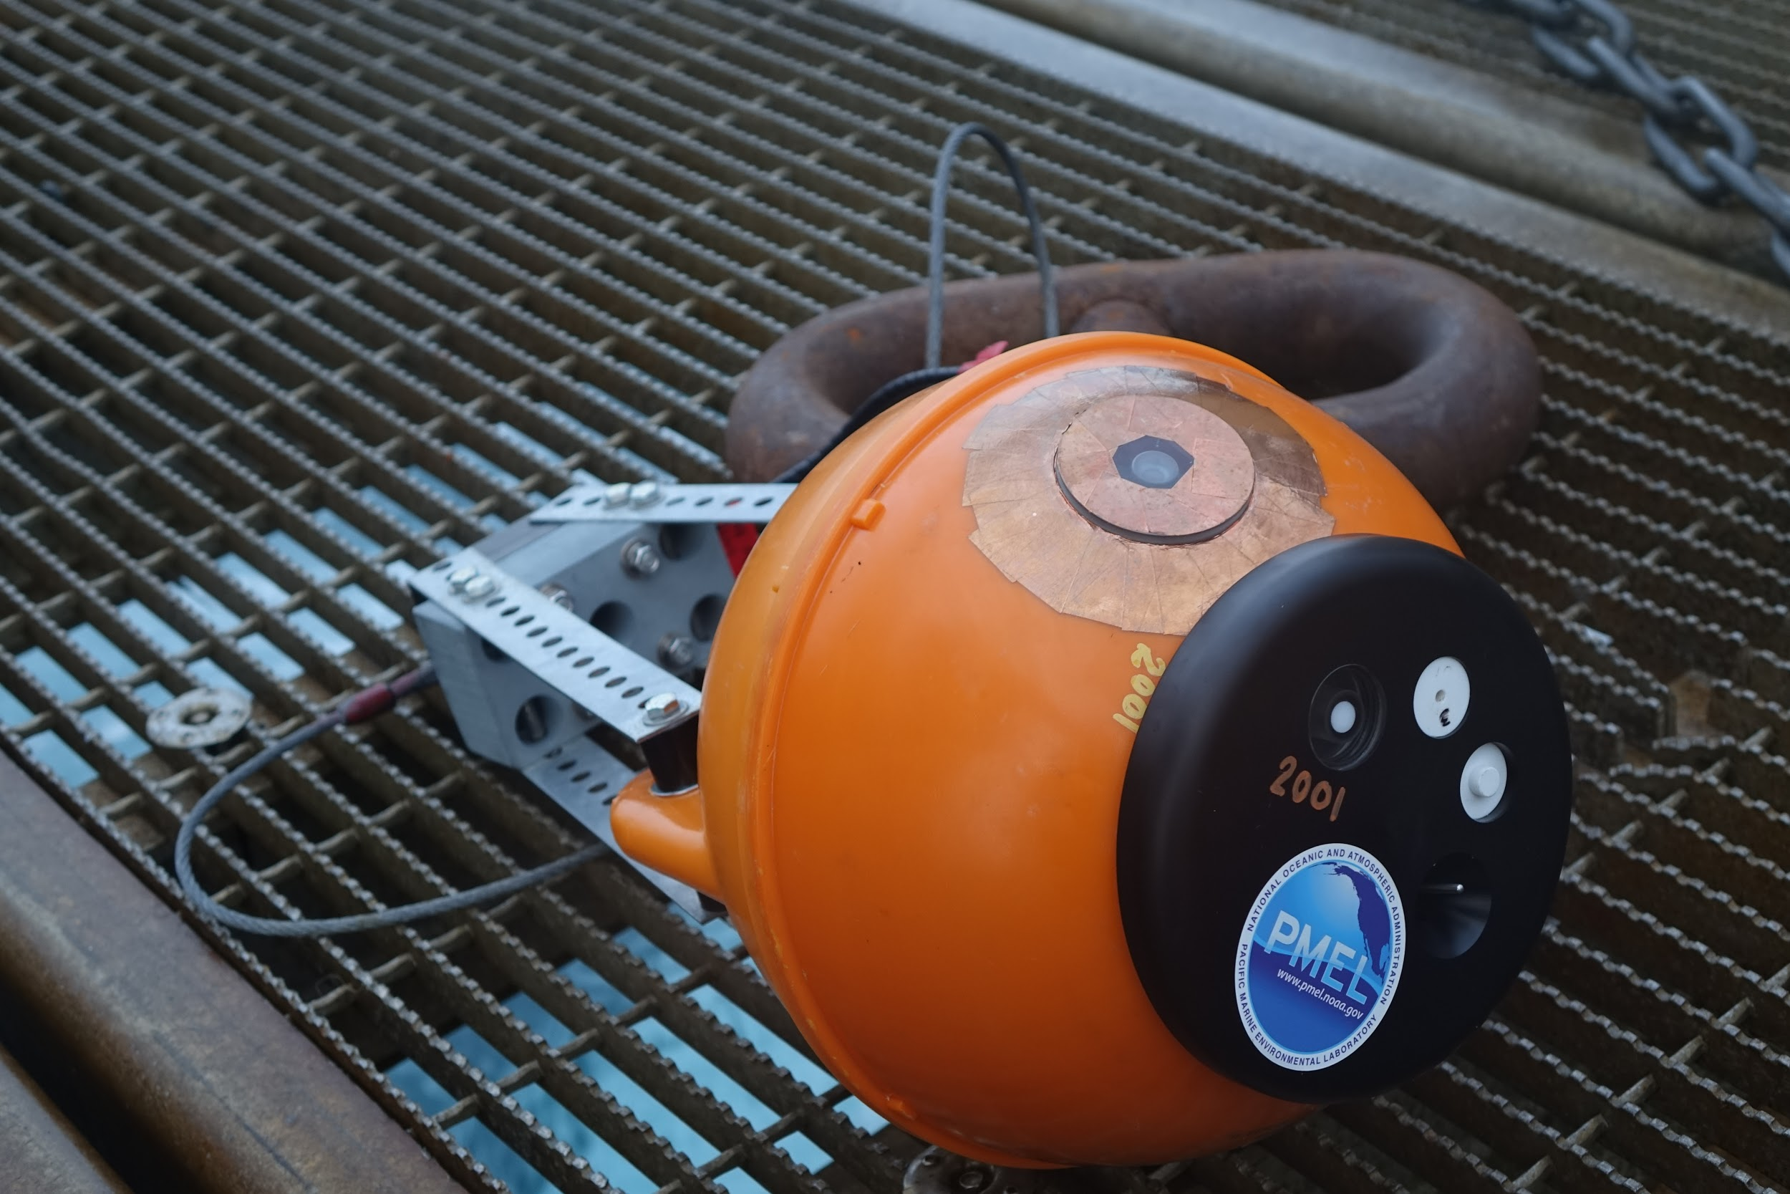
The use of innovative pop-up floats to explore Arctic marine ecosystems
Sarah Donohoe, NOAA Corps, Seattle, USA
sarah.s.donohoe@noaa.gov
Pacific Marine Environmental Laboratory
Notes:
Hello and welcome everyone! I am Sarah Donohoe, I work as a support engineer for NOAA PMEL.
Today I will be talking about “The use of innovative pop-up floats to explore Arctic marine ecosystems”.
And a little bit about me: I hold a technical position where I am hands-on with testing, calibrating and programming the pop-up floats.
I am from Juneau, Alaska and currently live and work in Seattle, Washington.
Thank you for listening to my talk on “The use of innovative pop-up floats to explore Arctic Marine Ecosystems”
Links to additional information:
pmel.noaa.gov
Who We Are | ITAE
"...Bering Sea residents take on more research duties" by Yareth Rosen
“Seasonal patterns of near-bottom chlorophyll fluorescence in the eastern Chukchi Sea: 2010-2019. Stabeno et al, 2020”
“Low-Cost Expendable Buoys for Under-Ice Data Collection. Langis et al, 2018”
-Sarah Donohoe, NOAA/PMEL
sarah.s.donohoe@noaa.gov

Slide 2
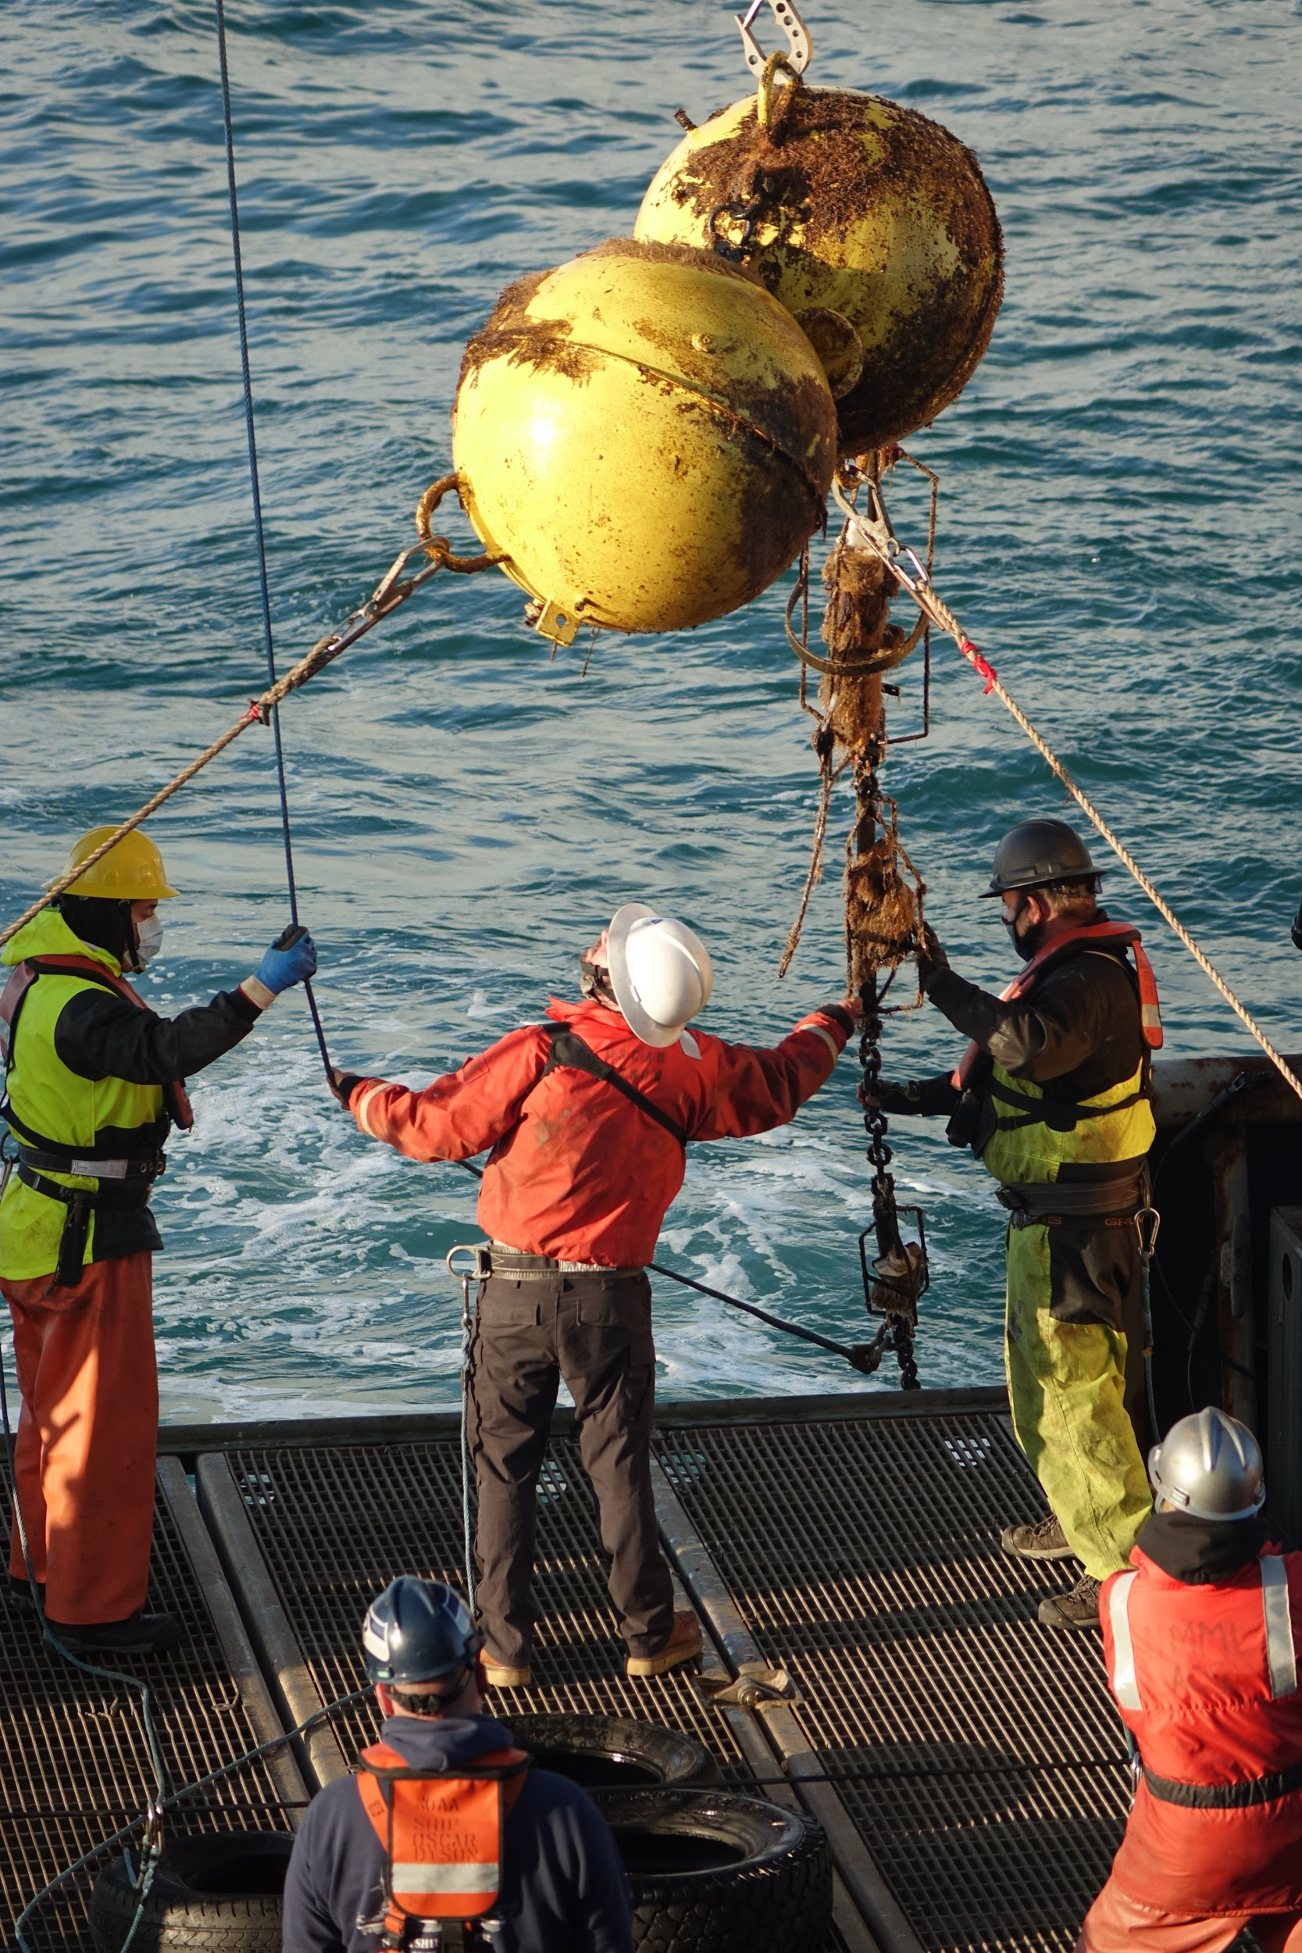
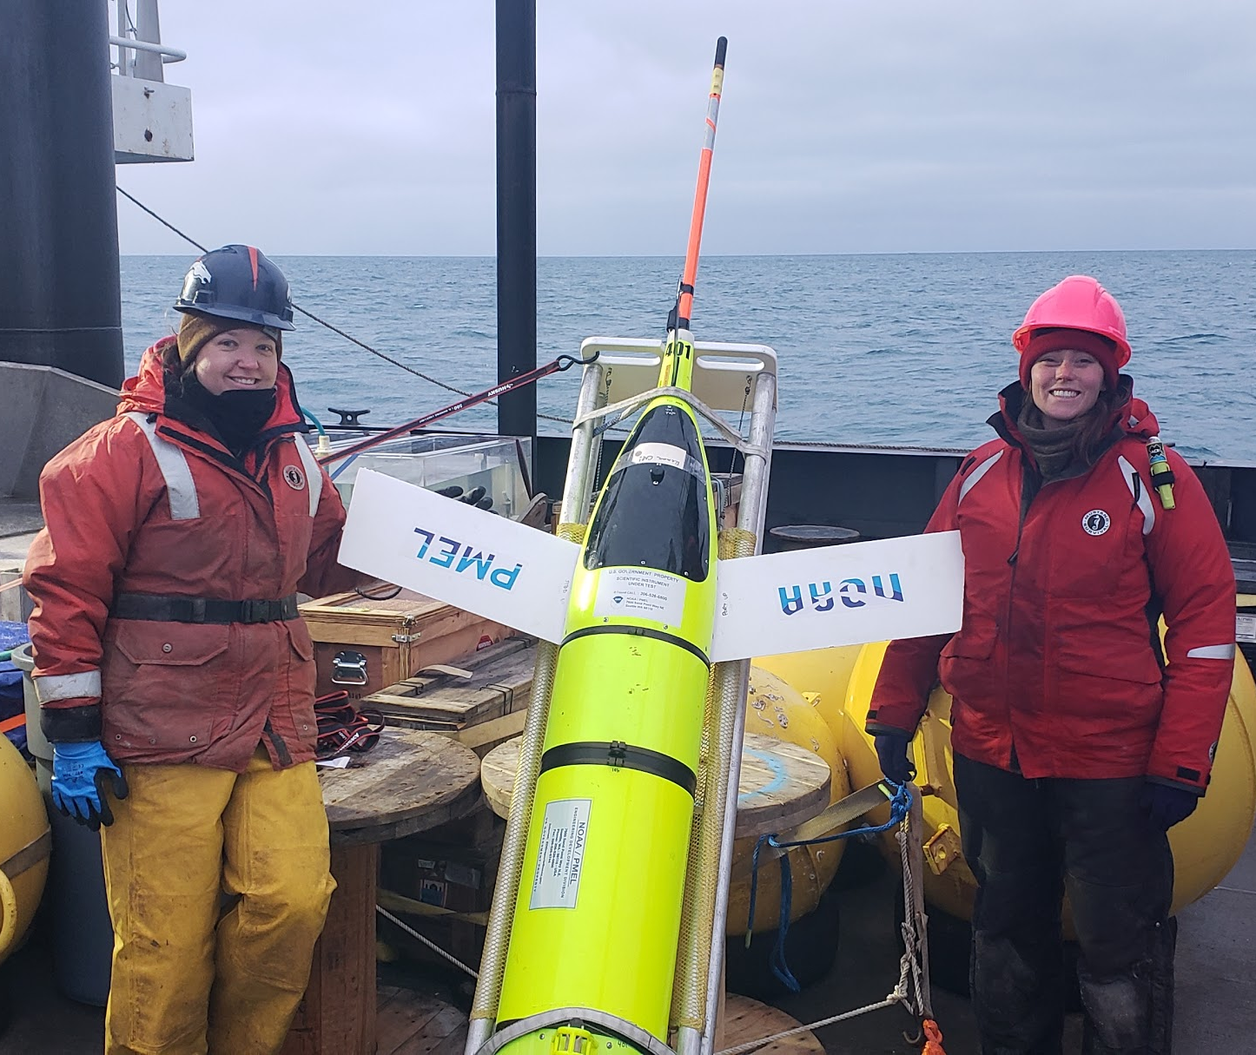
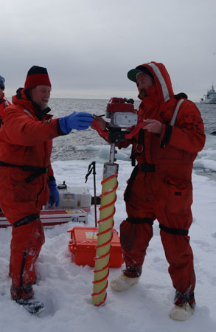
Pop-up floats fill a technology gap to collect data under sea ice in the Chukchi Sea
Sub-surface moorings measure bottom 30 meters
Gliders generally have to avoid sea ice
Ice-Coring opportunities are rare
Recovering a sub-surface mooring aboard the NOAAS Oscar Dyson in August 2020 (pc Sarah Donohoe)
Stephanie Grassia(AFSC/MML) and Sarah Donohoe(PMEL/FOCI) with an Oculus Glider in October 2018 (pc Catherine Berchok)
Ned Cockelet(PMEL/FOCI) and Matt Wilson(AFSC) with an Ice-Corer in 2006 (pc PMEL/FOCI )
Notes:
Pop-up floats fill a technology gap to collect data under sea ice in the Chukchi Sea
What does this mean?
At PMEL we use a variety of assets to collect data in the Arctic...
Including moorings, autonomous vehicles and many ship-based measurements!
But how do we collect data directly under seasonal sea ice?
It is a challenging study environment.
The dynamic sea ice can easily destroy instruments. Sea ice keels measure in some places up to 20m deep!
For this reason we keep sub-surface moorings to the bottom 30 meters of the water column so that deep sea ice keels don’t destroy them.
Similarly, autonomous gliders must avoid the hazards of the marginal ice zone, where ice is rafting and could smash the glider at the surface
Finally, Ice-Coring does allow PMEL scientists to get data from directly under the sea ice, but opportunities for such work are rare!
This leaves a need for a cost-effective, autonomous way to get oceanographic quality measurements at the marginal ice zone.
And that is why we developed the pop-up float!

Slide 3
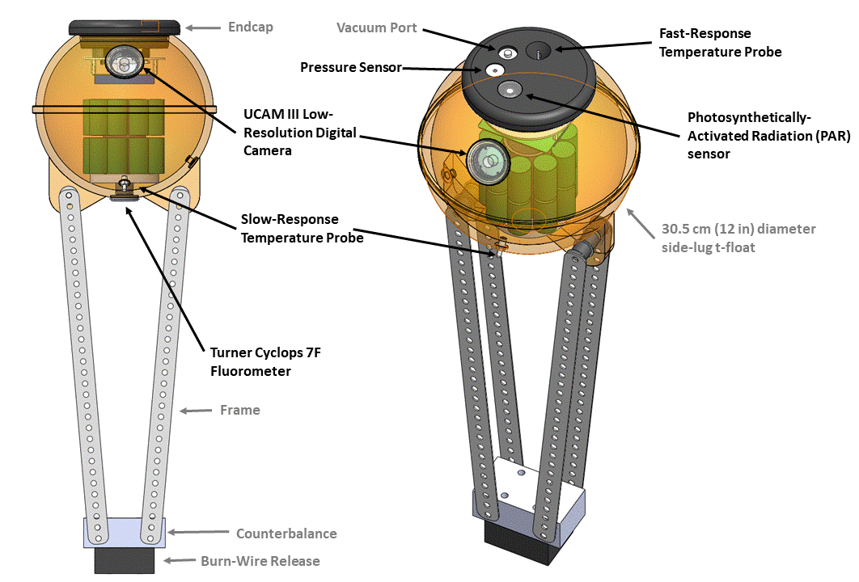
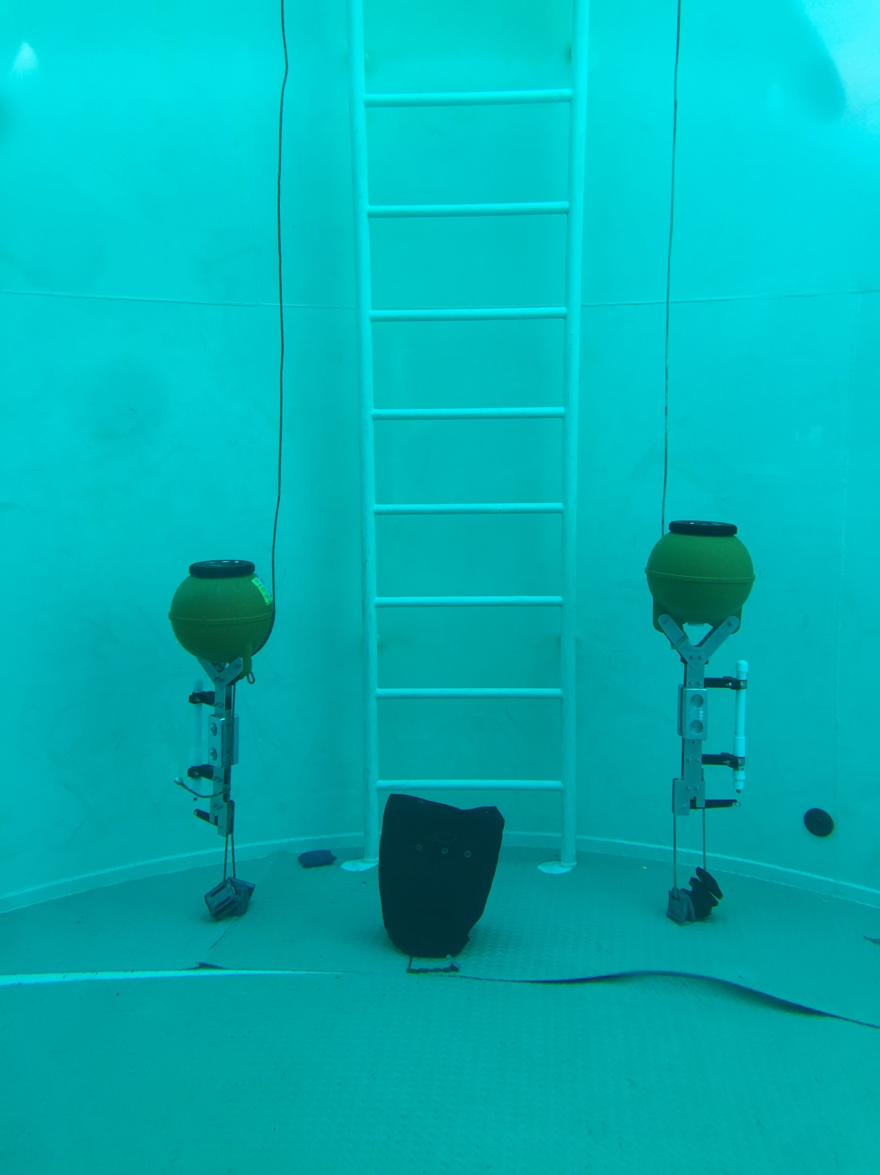
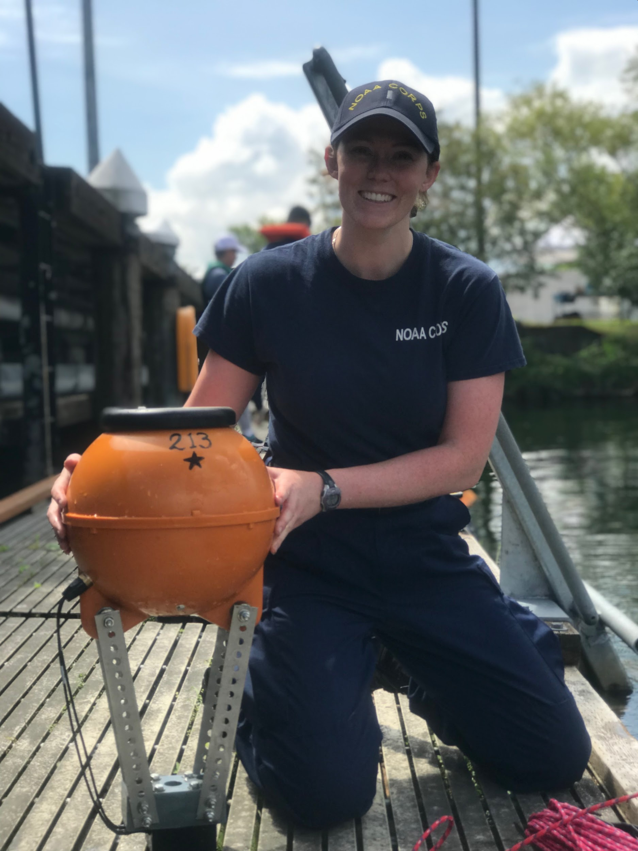
Pop-up floats are autonomous, low-cost and provide oceanographic-quality data
LTJG Sarah Donohoe poses with a pop-up float after a test-deployment in Lake Washington (pc Heather Tabisola)
Two pop-up floats anchored at the bottom of a pool at the NOAA Western Regional Center (pc Sarah Donohoe)
Notes:
Pop-up floats are autonomous, low-cost and provide oceanographic quality data
The float is housed in a commercially available orange trawl float
Through-hull ports are machined into the float to accept a suite of sensors that remain water-tight with o-ring seals
Sensors that we have integrated into the float are:
A Fluorometer
Two Temperature Probes
A Low-resolution Camera (to capture ocean color under sea ice)
A Pressure sensor
and
A PAR sensor (to measure light levels useful for primary producers)

Slide 4
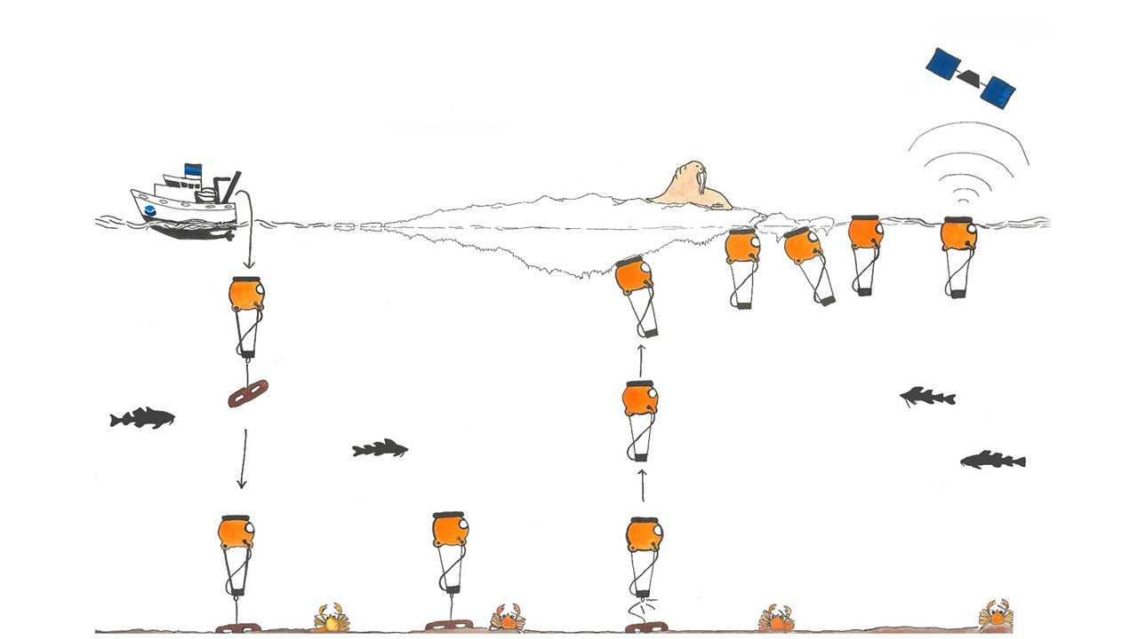
Pop-up floats function in 5 phases
Deploy: from ship in ice-free conditions
Bottom: logging measurements hourly
Profile: float rises after releasing the anchor, collecting measurements at 4Hz
Under Ice: logging measurements hourly and taking daily images
Surface: transmits logged data via Short-Burst-Data messages, then collects measurements every 3 hours until battery expires
Deploy | Bottom | Profile | Under Ice | Surface
SEP | OCT | NOV | DEC | JAN | FEB | MAR | APR | MAY | JUN | JUL | AUG
Notes:
How does a pop-up float collect data in the Arctic?
It’s simple. The float moves through 5 phases.
First, deployment: A vessel deploys the float by hand in the fall
Second, bottom logging. The float records hourly measurements while anchored to the bottom of the seafloor through the winter months (usually October through March)
Third, profile. The float is pre-programmed with a burn-wire release date in the early spring.
It drops the link that tethers it to it’s anchor, and the float collects a single profile at 4Hz frequency as it rises up the water column.
Fourth, under ice! If sea ice is present, the float will be trapped under an ice-floe and continue to log hourly measurements and, in addition, take daily low-resolution ocean color images
Fifth, surface. When the seasonal sea-ice retreats the float reaches the sea surface and sends logged measurements via Short-Burst-Data Iridium Satellite communication back to my email inbox.

Slide 5
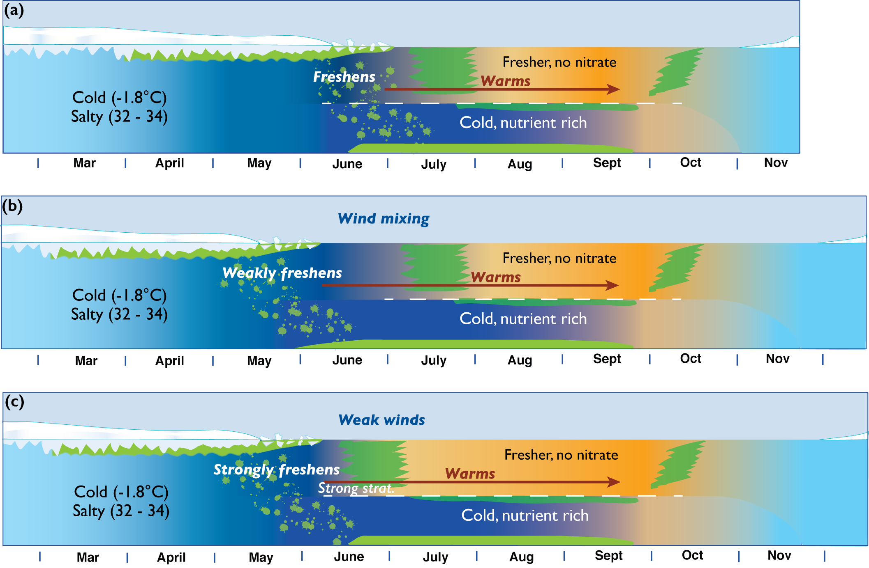
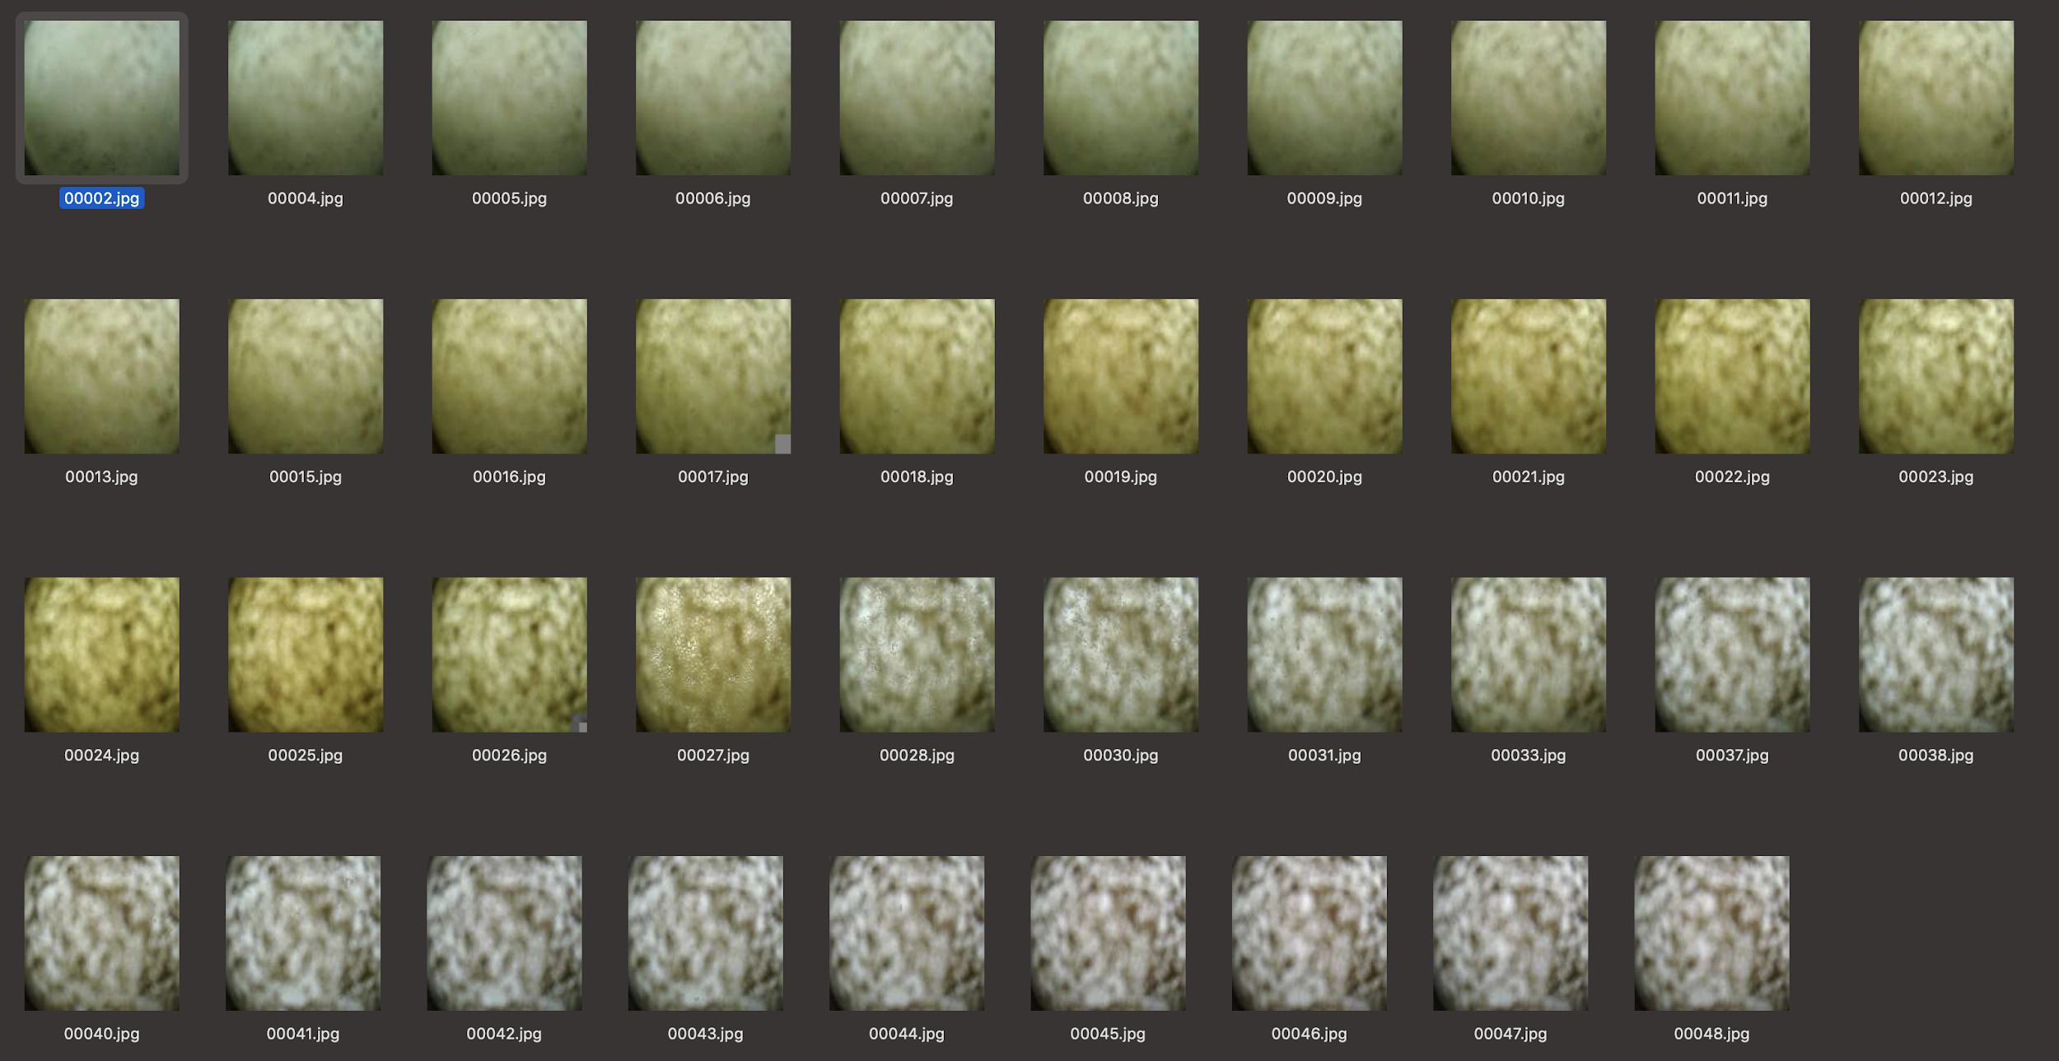
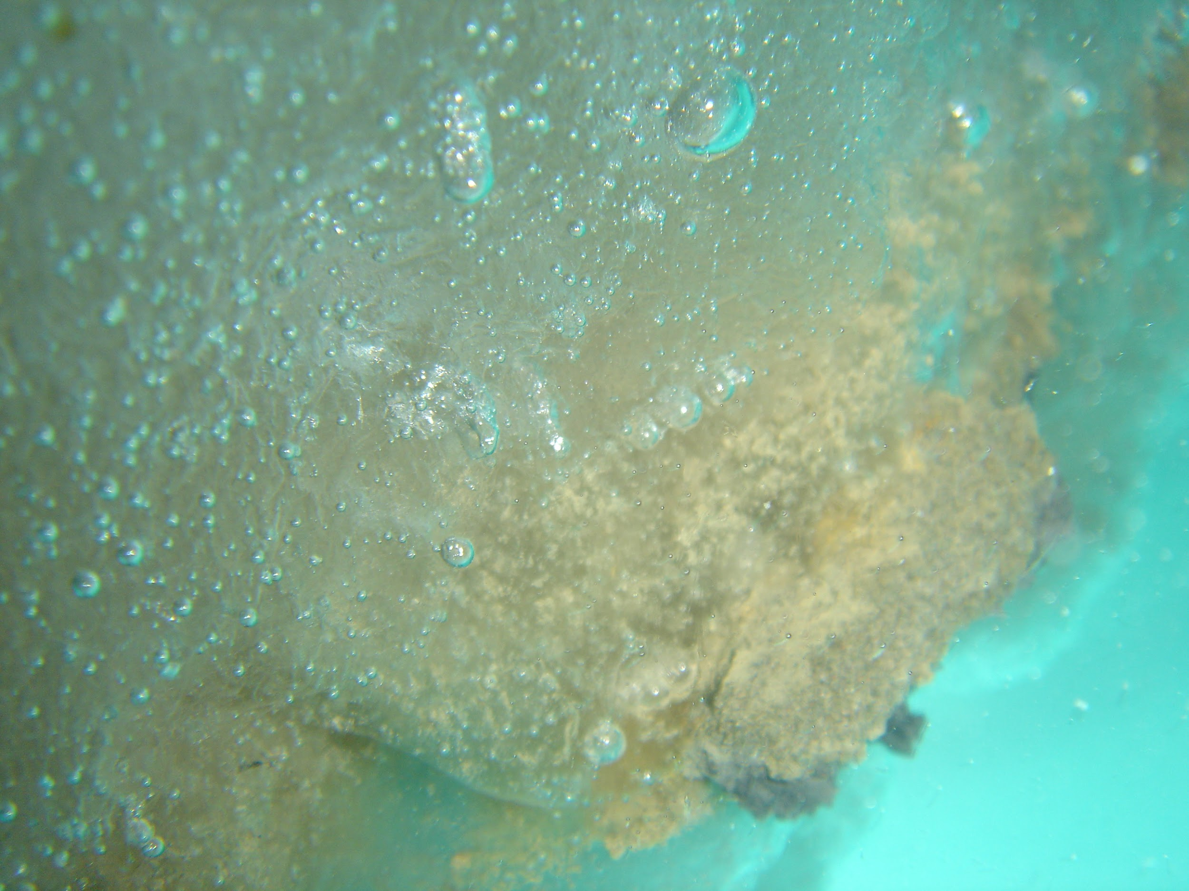
Pop-up floats measure under-ice production in the Chukchi Sea
Under-Ice photos show ice algae, taken by NOAA Ship Miller Freeman Diver in April 2006 (pc Shawn Cimilluca)
Under-Ice photos show ice algae, taken by pop-up float 1240 in May and June, 2019 (pc PMEL/FOCI)
Notes:
Pop-up floats meet our goals of getting measurements right underneath marginal sea ice in the Under-Ice phase
When floats are trapped under sea-ice they collect hourly measurements and daily camera images revealing ocean color, which can act as an indicator for ice algae blooms.
The figure on the upper right shows the progression of an ice-algae bloom that initiates on and in the sea ice substrate, then falls from the sea ice to the sea floor during spring ice melt.
This photo in the lower left of ice algae was taken by a diver with a high-resolution camera… in the lower right the low resolution ocean color images were taken by a pop-up float.
They are not as pretty! But they do have some use! In this case, the float was able to take daily images and show the progression of an ice algae bloom using ocean color.

Slide 6
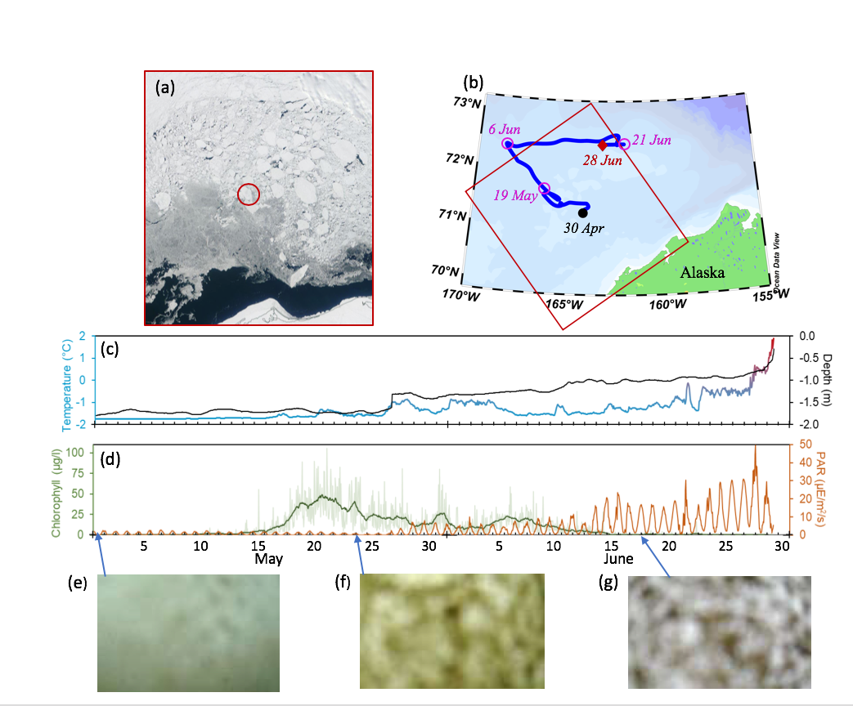
Under-ice data and satellite images tell the story of an ice-algae bloom in May 2019
A pop-up float surfaced under a 2km long ice floe on April 30th, 2019
The floe was tracked with satellite imagery and followed the blue trajectory in figure b.
Fluorescence signal and ocean color images indicate an ice-algae bloom from May 15th to June 15th 2019
Stabeno, Mordy & Sigler, 2020
Notes:
Under-ice data and satellite images tell the story of an ice-algae bloom in May 2019.
Here we show a pop-up float that surfaced under a 2km long ice floe on April 30th, 2019
b.
The floe was tracked with satellite imagery and followed the blue trajectory in figure b.
On Jun 28th, the ice floe broke apart and the pop-up float reached the surface to transmit data back to the lab!
The under-ice phase data that came back from the float is shown here
c.
Figure c depicts temperature and depth data in the under-ice phase.
One thing that is interesting to note is that the pressure (or depth) in the under-ice phase is giving us the keel depth of the ice floe.
You can clearly see keel depth decreasing and temperature increasing as the floe melts
Because of this we can see the thinning of the ice starting at around 1.8m in late April, and then beginning abruptly on around May 28th thinning to 1.2m and continuing to thin out until break up when the float reached surface on Jun 28th
You can see clearly that temperatures remain right at -2 until around 15 May when temperatures begin to rise slowly, and then faster around 27 June.
d.
Figure d depicts chlorophyll and PAR during the under-ice phase.
Fluorescence signal (in green) and ocean color images indicate an ice-algae bloom from May 15th to June 15th 2019
PAR diurnal signal strength increases with the thinning of the ice
These figures were published in Deep-Sea Research Part II by Stabeno, Mordy and Sigler in 2020
“Seasonal patterns of near-bottom chlorophyll fluorescence in the eastern Chukchi Sea: 2010-2019”

Slide 7
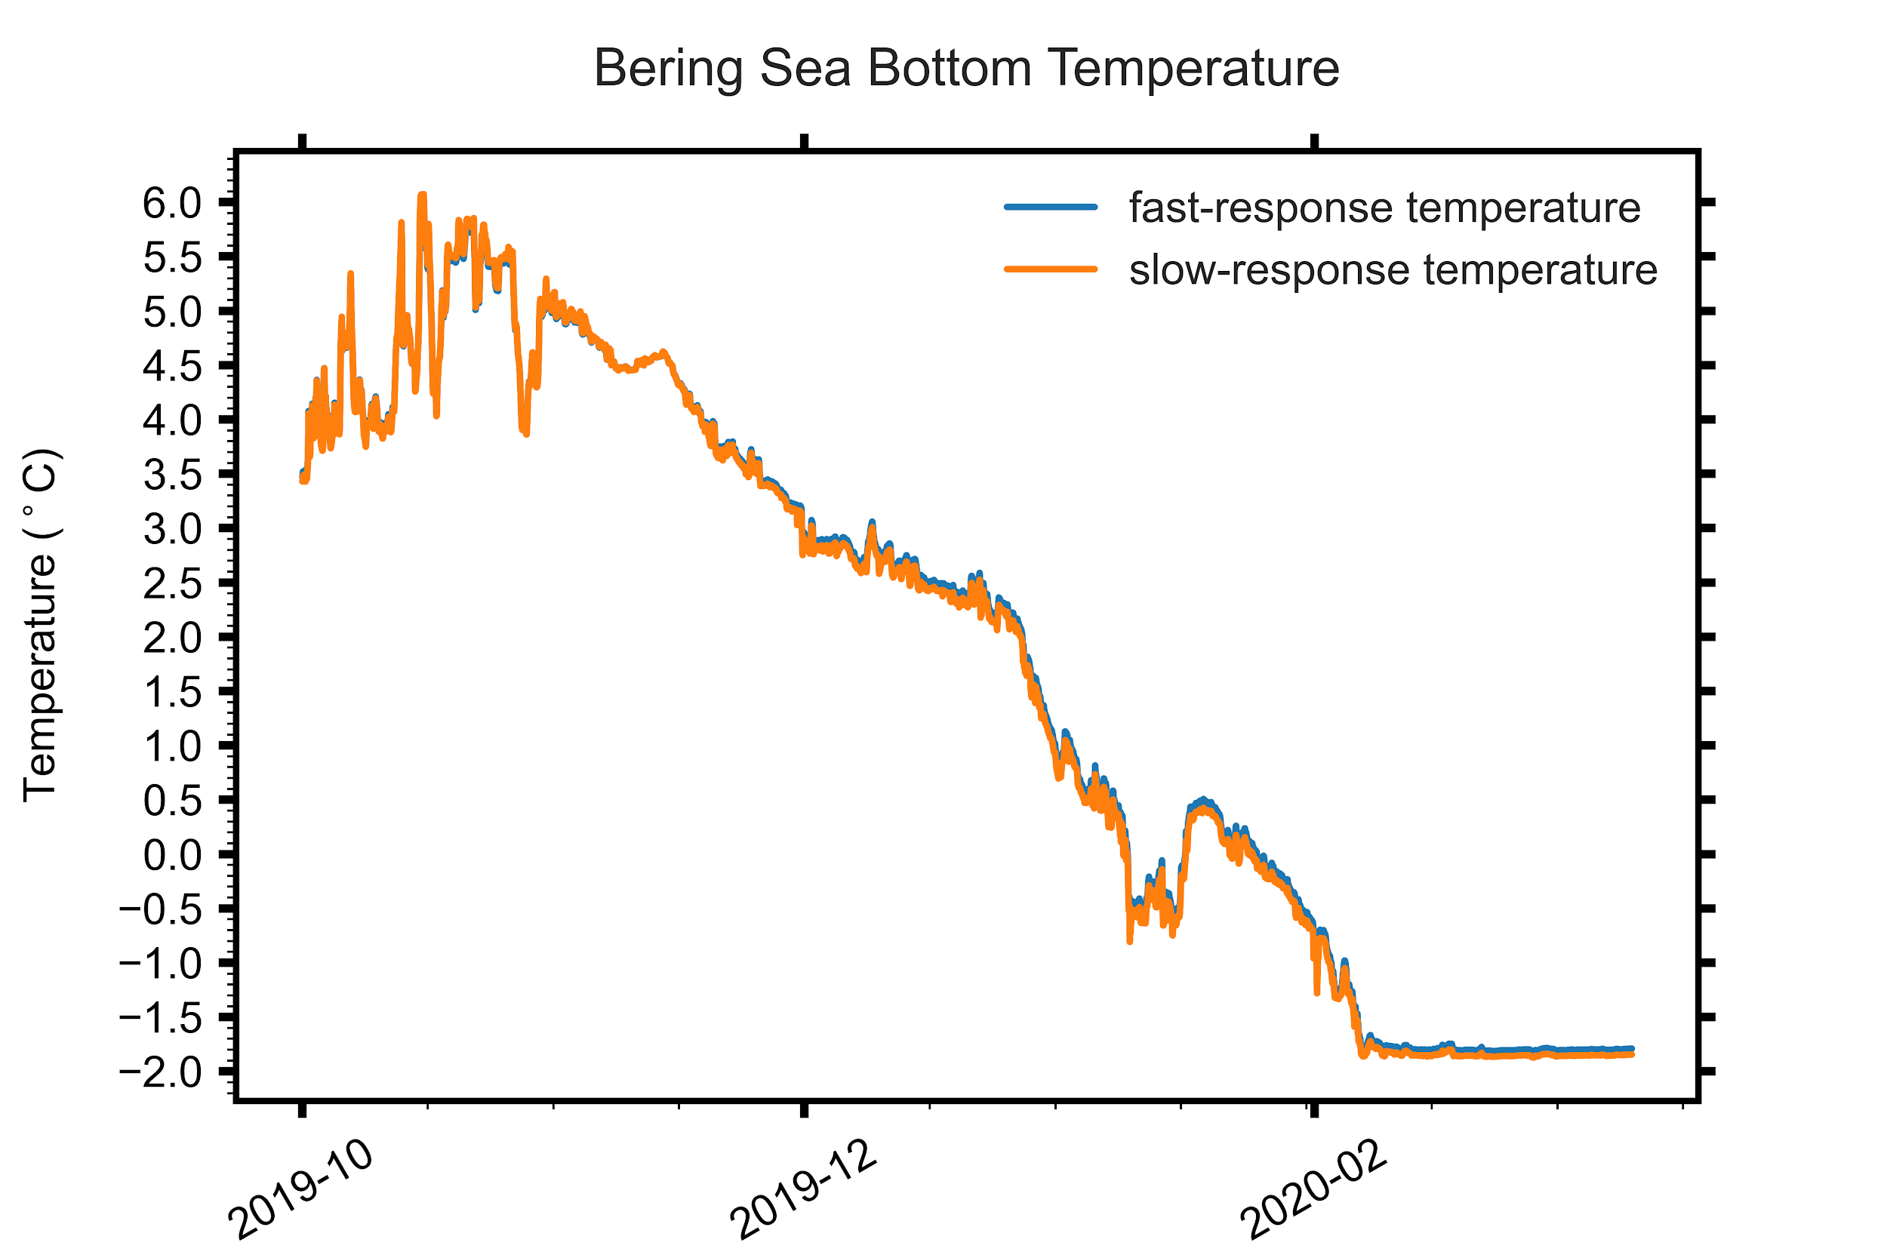
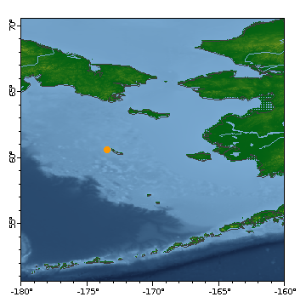
Pop-up floats measure bottom-temperatures to map Bering Sea cold pool (<2℃)
Notes:
Pop-ups were developed to investigate under-ice productivity, but they have other uses as well.
Pop-up floats can map the Bering Sea cold pool.
The cold pool is a layer of cold bottom water that is 2°C or less and occurs near the seafloor. It results from melting sea ice in the winter and spring.
In the figure on the upper right, the bering sea cold pool is labelled as cold and nutrient rich
The Bering Sea cold pool is of interest because It creates a barrier for commercially important fish species like Pacific cod and pollock that prefer warmer waters.
The figure in the bottom left shows pilot study data from a pop-up float in the Bottom logging phase.
It shows formation of the 2C or less cold pool occurring in late January of 2020 near St. Matthew Island

Slide 8
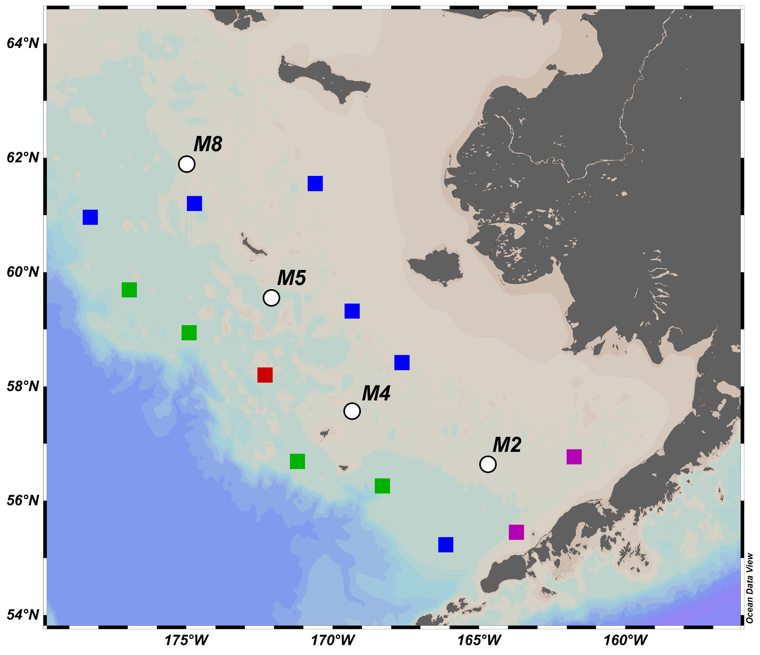
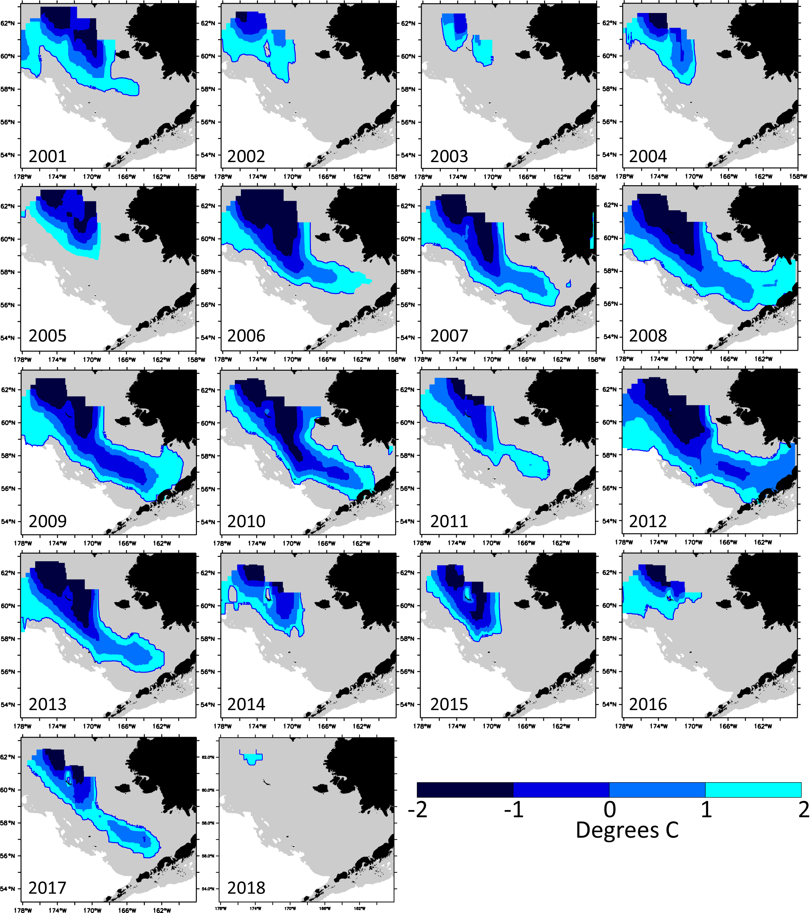
Model of cold pool dynamics is fed by bottom-temperature time-series at M sites
Notes:
We know the cold pool extent each year through long-term mooring sites (M sites) that provide bottom temperature time-series at M8, M5, M4 and M2 shown on the left. The bottom-temperature data is integrated into a model that is useful for mapping the Bering Sea cold pool extent.
The figure on the right shows historical model output of the cold pool, based on time-series bottom temperature data from sites M8, M5, M4 and M2
Adding additional spatial coverage by deploying pop-ups across the shelf can give us a more complete picture of the cold pool.

Slide 9
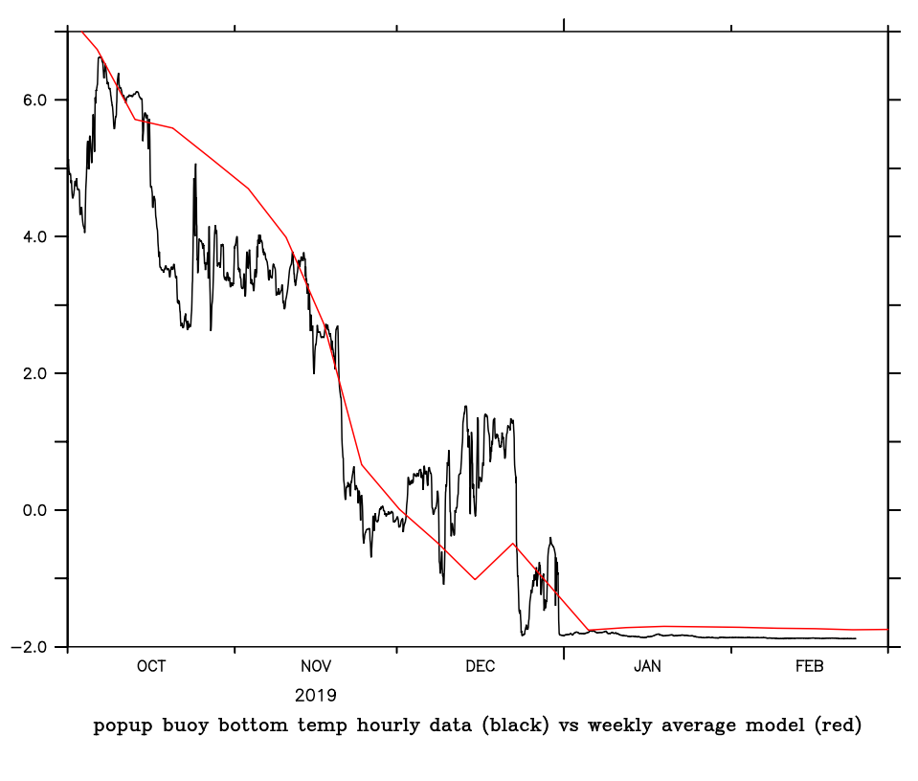
Pop-up floats to improve ROMS model of cold pool dynamics
Project Goals
expand observations of seasonal bottom temperatures across the EBS through deployment of PUFs
use those data to validate and assess ROMS model error and bias with respect to cold pool dynamics
formally assimilate new data into ROMS model for improved “hindcasts”
Use improved ROMS and known relationships between temperature and Pacific cod spawning success to characterize suitable habitat for spawning in the EBS
project the spatial distribution and timing of suitable spawning habitat under future climate scenarios
introduce this information into the management process for Pacific cod.
Fishing
industry
Dyson
Aleut Community St. Paul
US Coast
Guard
NPRB Ongoing Proposal, Rogers et al., 2020-2023
Notes:
And so, that’s what we did!
Currently the pop-up floats are being used in an ongoing NPRB proposal to increase spatial coverage of bottom temperature time-series
to improve the ROMS Regional Ocean Modeling System (ROMS, Haidvogel et al 2000, Schepetkin and McWilliams 2005)
model of the Bering Sea cold pool
the bottom right shows a pilot hind-cast comparison between a pop-up float deployed in 2019 and ROMS model output.
They actually agree pretty well, and give us confidence that the ROMS cold pool model is performing well.
Still… The more spatial coverage we can get of bottom-temperatures, the better the model can be.
The additional colored squares in the map mark where pop-ups were deployed in 2020 to this end.

Slide 10
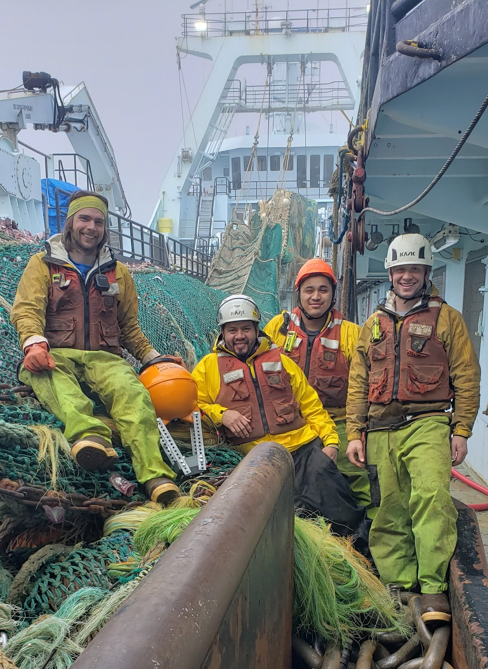
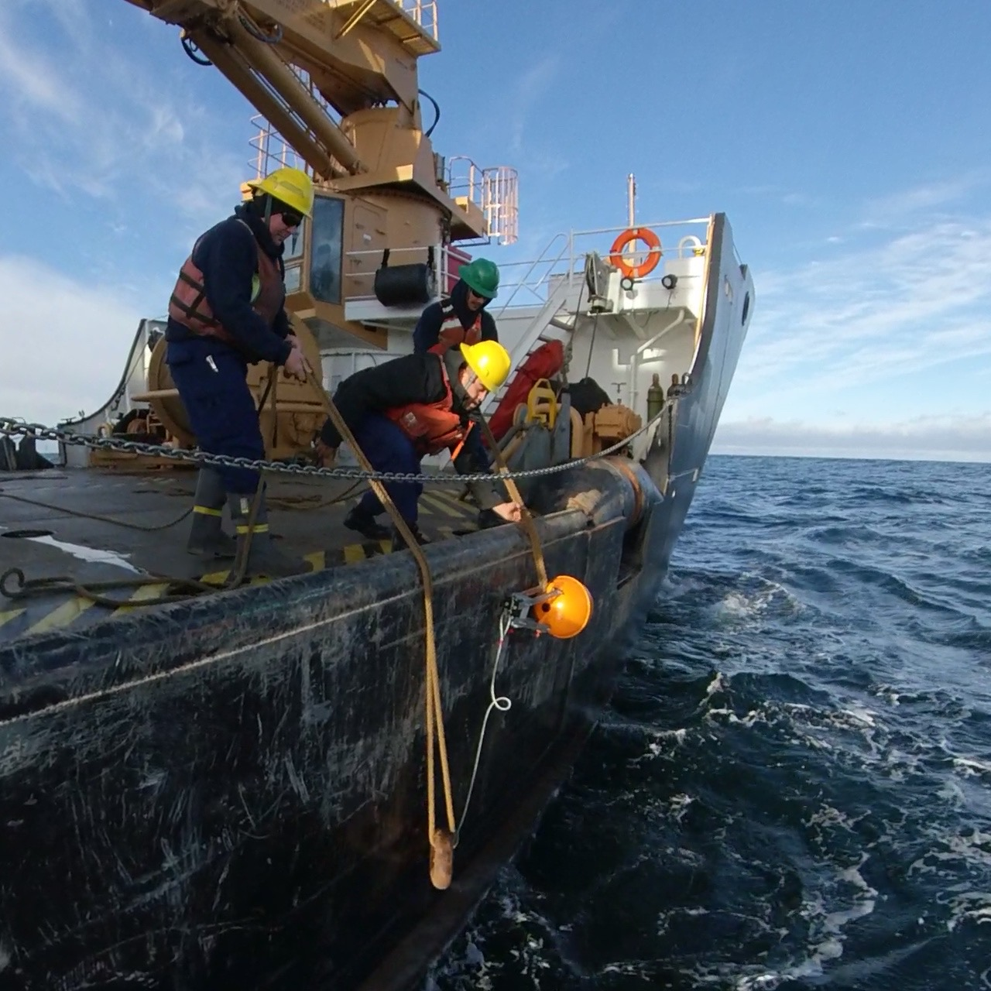
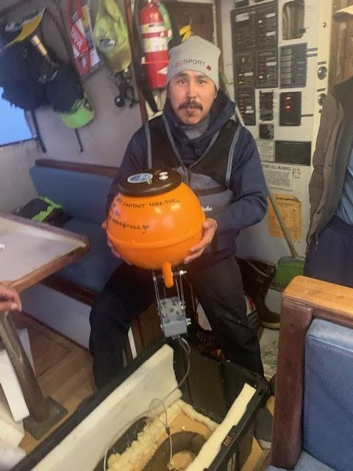
Pop-up floats deployed by the fishing industry, the U.S. Coast Guard and the
Aleut Community of Saint Paul Island
C/P Starbound, August 2020
Left to right: Tylar Lowen ; Walter Miranda ; Reynaldo Pio ; Caleb Rodriguez. ( pc Susie Zagorski)
U.S. Coast Guard Cutter Fir, October 2020
(pc U.S. Coast Guard Cutter Fir)
F/V Karen Ann, October 2020
Andronik Hanson. (pc President of the Aleut Community of St. Paul Island, Amos Philemonoff)
Notes:
AND In 2020, due to COVID-19, a number of research cruises were cancelled.
Deployments were transitioned to various local stakeholders and partners
4 floats were deployed by commercial fishing vessels F/V Westward1 and C/P Starbound,
2 floats were deployed by the United States Coast Guard Cutter Fir and
1 float was deployed by the Aleut Community of St. Paul Island, Alaska.
We are very thankful for these partnerships and we’re hopeful that they can continue in the future!

Slide 11
Thank you to co-authors and contributors!
Phyllis Stabeno, NOAA/PMEL, Seattle, USA
Calvin Mordy, University of Washington, Seattle, USA
Albert Hermann, University of Washington, Seattle, USA
Heather Tabisola, University of Washington, Seattle, USA
Thomas Van Pelt, University of Washington, Seattle, USA
Shaun Bell, University of Washington, Seattle, USA
Pop-Up Float Takeaways
inexpensive and autonomous
useful for under-ice production studies
useful for mapping the cold pool
flexible for a variety of research interests
partnership building platforms for local stakeholders
Sarah Donohoe, NOAA Corps, Seattle, USA
sarah.s.donohoe@noaa.gov
Pacific Marine Environmental Laboratory
Notes:
To conclude, the pop-up floats are inexpensive, useful for under ice production studies, help map the cold pool, can be used flexibly in a variety of studies and are partnership building platforms for local stakeholders.
I want to thank the co-authors at NOAA/PMEL at University of Washington that have been working on this project and made all of this possible.
And, THank YOu! for inviting me to ASSW to share with you today.
Thank you for listening to my talk on “The use of innovative pop-up floats to explore Arctic Marine Ecosystems”
Links to additional information:
pmel.noaa.gov
Who We Are | ITAE
"...Bering Sea residents take on more research duties" by Yareth Rosen
“Seasonal patterns of near-bottom chlorophyll fluorescence in the eastern Chukchi Sea: 2010-2019. Stabeno et al, 2020”
“Low-Cost Expendable Buoys for Under-Ice Data Collection. Langis et al, 2018”
-Sarah Donohoe, NOAA/PMEL
sarah.s.donohoe@noaa.gov
Abstract
The pop-up float is a small, low-cost, moored, autonomous float designed for easy deployment and data collection in the challenging seasonal sea ice zones of the Bering and Chukchi Seas. It was developed to fill a gap in available technology between year-round moorings and surface-based sampling in summers with a unique engineering approach. Since 2017, 14 floats have been field tested in the Bering (11) and Chukchi (3) Seas with 11 of those floats (79%) successfully returning temperature, location, photosynthetically-active radiation (PAR), fluorescence data and under-ice camera images via Iridium satellite short-burst data messages. Pop-up floats can provide insight into the winter extent of the Bering Sea cold pool and levels of algal biomass under seasonal Arctic sea ice. The small and easy-to-deploy pop-up floats are uniquely situated to be deployed by ships of opportunity. In 2020, due to COVID-19, deployments were transitioned to various partners with 1 float deployed by the Aleut Community of St. Paul Island, Alaska, 4 floats deployed by commercial fishing vessels F/V Westward1 and C/P Starbound, and 2 floats deployed by the United States Coast Guard Cutter Fir. In this presentation we will share the pop-up float design, function, and preliminary data as well as discuss their potential as a partnership building platform for autonomous, in-situ data collection in the Arctic.

